Slide 1
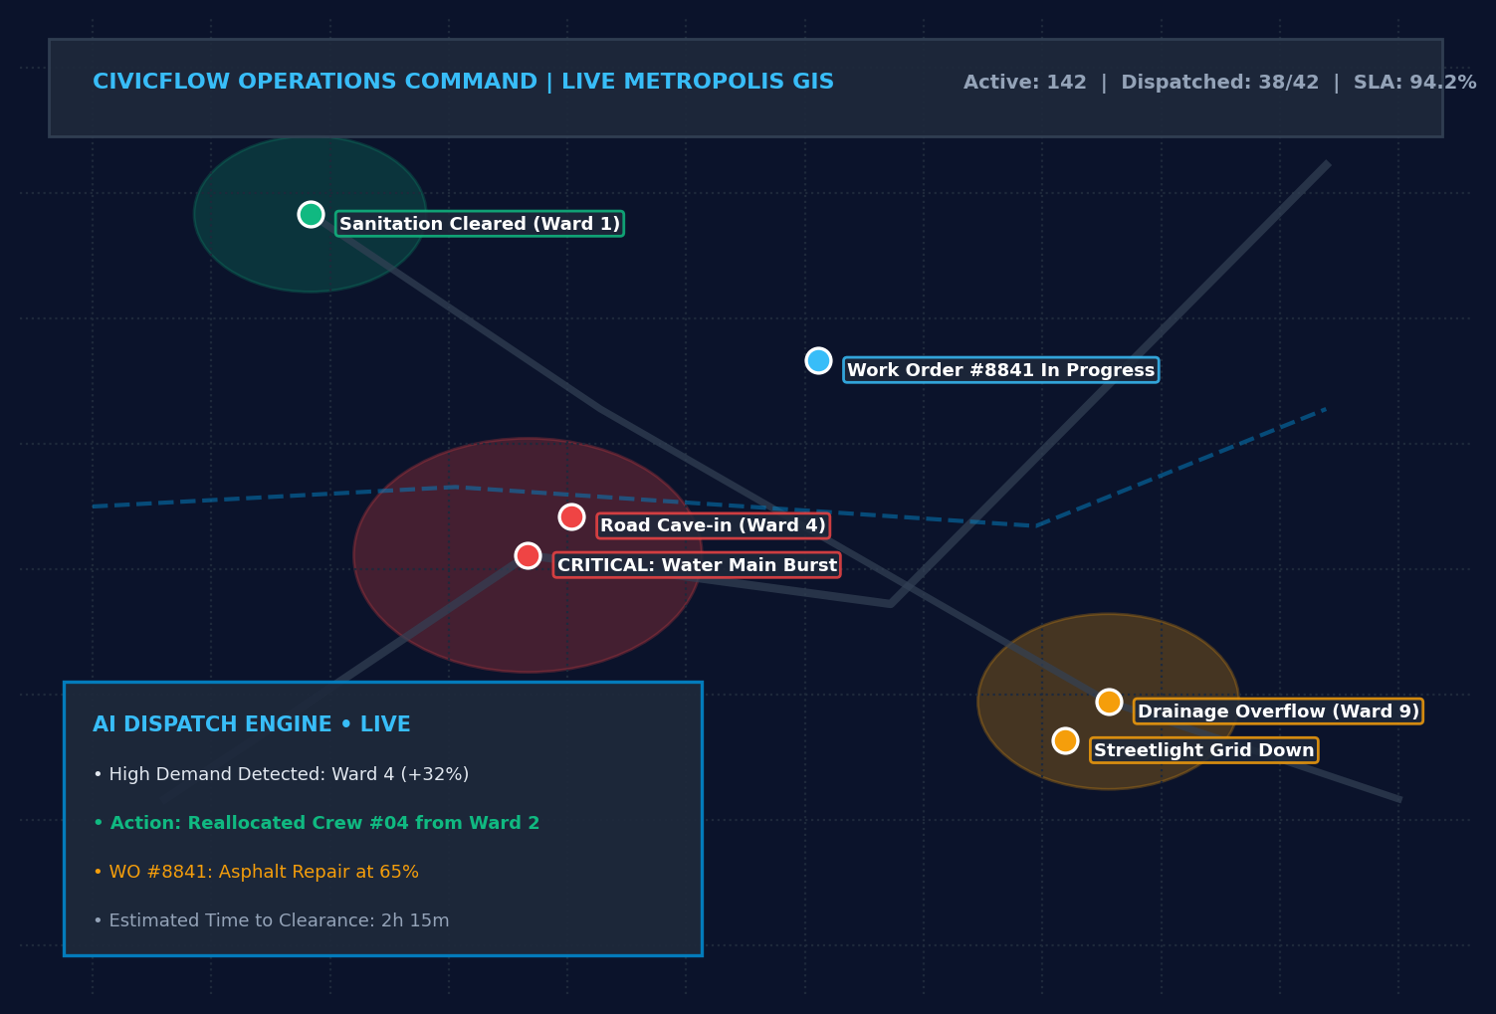
INIT-HACK 2.0 – HACKATHON 2026 | B.TECH INNOVATION
CIVICFLOW AI
AI-Powered Urban Service Demand &
Resource Allocation Platform
Tagline: "From Civic Problems to Intelligent Action"
TEAM DETAILS & PARTICIPANTS:
Team Name: mugiwara's kizoku
Members: G Vishnu Madhav & B Yeswanth Obul Reddy
Institution: B.Tech Engineering Dept | Track: Urban Operations AI
CIVICFLOW AI | INIT-HACK 2.0 (2026) | Team: mugiwara's kizoku
Slide 1 of 18

Slide 2
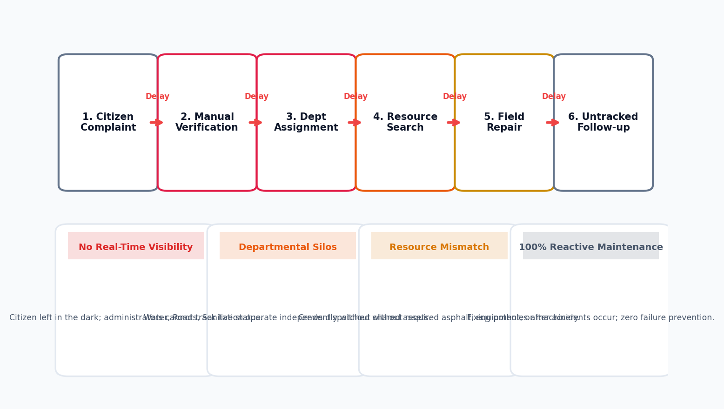
URBAN OPERATIONS CHALLENGE
Urban Civic Problems Are Managed Reactively
Cities face continuous infrastructure degradation while municipal departments operate in isolated silos.
REACTIVE BOTTLENECK ANALYSIS
• Endless Recurring Hazards:
Road potholes, water main bursts, sewer blocks, and streetlight outages repeatedly resurface without root-cause prevention.
• Manual Multi-Hop Handoffs:
Complaint -> Manual verification -> Bureaucratic assignment -> Unchecked material search -> Delayed field execution.
• Resource Blind Spots:
Sanitation and road repair crews are dispatched without knowing exact site dimensions, required asphalt tonnages, or machinery.
• Zero Operational Visibility:
Neither citizens nor city commissioners can inspect live repair status, resulting in duplicate calls and citizen dissatisfaction.
• Chronic Workload Imbalance:
Critical wards sit overwhelmed with 10+ backlog tickets while neighboring zones maintain underutilized crews.
CIVICFLOW AI | INIT-HACK 2.0 (2026) | Team: mugiwara's kizoku
Slide 2 of 18

Slide 3
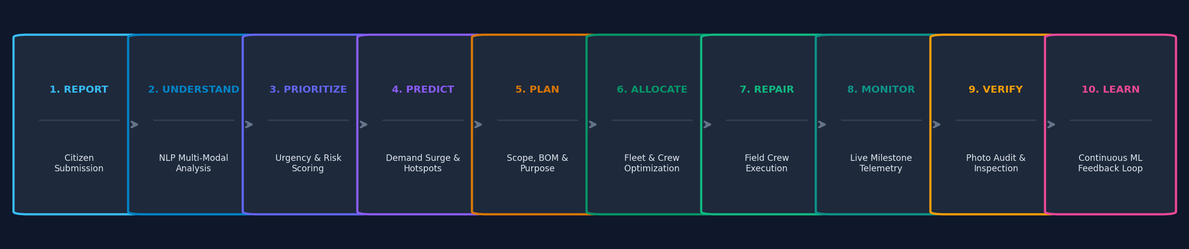
ENTERPRISE PARADIGM SHIFT
Introducing CivicFlow AI: The Urban Operations Intelligence Platform
CivicFlow AI is NOT a basic complaint portal. It is a full-lifecycle operational operating system for smart cities.
AI & GIS Intelligence
Ingests unstructured citizen reports, extracts exact damage categories via NLP, and maps spatial density to detect geographic hotspots.
Dynamic Resource Optimization
Converts tickets into engineered work orders. Matches required asphalt, pipe inventory, machinery, and nearest skilled crews automatically.
Closed-Loop Governance
Tracks real-time progress percentages, geo-tagged inspection photos, and post-repair telemetry to transition from reactive patching to preventive care.
CIVICFLOW AI | INIT-HACK 2.0 (2026) | Team: mugiwara's kizoku
Slide 3 of 18

Slide 4
ENGINEERING SCOPE
Project Objectives: Engineering a Closed-Loop Platform
Engineered to systematically replace manual bureaucratic handoffs with algorithmic municipal orchestration.
01. Automated Classification
Utilize multi-modal NLP to categorize unstructured citizen text, image tags, and assign objective severity scores within milliseconds.
02. Geospatial Hotspot Detection
Identify geographic clusters and recurring infrastructure failures using spatial clustering (DBSCAN) over municipal GIS layers.
03. Predictive Demand Forecasting
Forecast future service demand spikes across city wards using time-series modeling (ARIMA / Prophet) to eliminate response latency.
04. Resource & Crew Optimization
Optimize allocation of municipal workforce, specialized equipment, vehicles, and raw materials based on real-time availability.
05. Structured Digital Work Orders
Convert abstract service requests into actionable engineering work orders with precise repair scope and bill of materials (BOM).
06. Live Progress Auditing
Provide milestone-driven monitoring from dispatch to physical verification with tamper-proof supervisor photo logs.
07. Bidirectional Transparency
Offer full tracking visibility to both citizens and city administrators, closing the municipal trust deficit.
CIVICFLOW AI | INIT-HACK 2.0 (2026) | Team: mugiwara's kizoku
Slide 4 of 18

Slide 5
OPERATIONAL WORKFLOW
Intelligent Civic Operations Lifecycle: 10 Operational Stages
Every civic event moves through an immutable, automated 10-stage execution and learning pipeline.
Stage 1: Report
Citizen submits issue with geotag, photos & description via portal.
Stage 2: Understand
NLP categorizes issue, extracts intent & measures severity score.
Stage 3: Prioritize
System computes priority: Severity x Population x Hazard Risk.
Stage 4: Predict
AI checks recurrence history & forecasts immediate ward impact.
Stage 5: Plan
Engineer defines scope, required materials (BOM), and schedule.
Stage 6: Allocate
Optimization engine assigns optimal crew, vehicle & inventory.
Stage 7: Repair
Field team receives mobile work order & initiates repairs.
Stage 8: Monitor
Tracks live progress %, material usage & GPS check-ins.
Stage 9: Verify
Supervisor conducts inspection & uploads geo-tagged proof.
Stage 10: Learn
Data updates ML recurrence models to prompt preventive care.
CIVICFLOW AI | INIT-HACK 2.0 (2026) | Team: mugiwara's kizoku
Slide 5 of 18

Slide 6
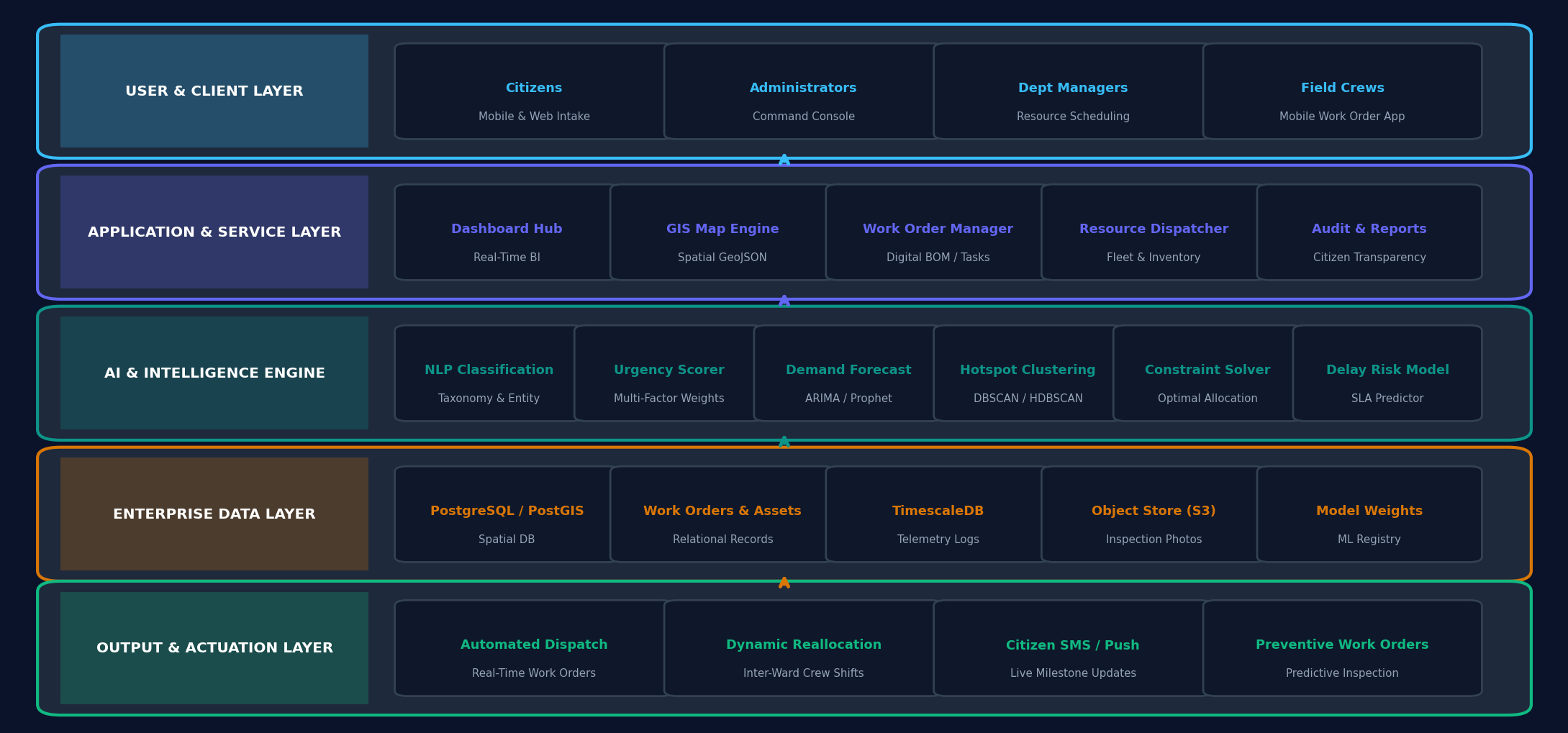
TECHNICAL ARCHITECTURE
CivicFlow AI — Multi-Tier System Architecture
Modular microservices blueprint orchestrating user intake, machine intelligence, and physical city actuation.
ARCHITECTURE HIGHLIGHTS
• Decoupled Microservices:
Frontend, AI inference, and database layers operate independently with REST/gRPC interfaces.
• Geospatial Processing:
PostGIS spatial indices enable sub-second spatial querying across millions of coordinate pairs.
• Asynchronous Job Queues:
Resource allocation solvers and Prophet models execute via Celery/Redis without blocking API threads.
• Enterprise RBAC:
Role-based access control separates public citizen views, engineer dispatches, and commissioner dashboards.
CIVICFLOW AI | INIT-HACK 2.0 (2026) | Team: mugiwara's kizoku
Slide 6 of 18

Slide 7
SYSTEM CAPABILITIES
Major System Modules: 6 Pillars of Civic Operations
Modular software services designed to operate cohesively as a unified municipal operations platform.
Module 1: Civic Service Intelligence
Multi-channel complaint ingestion, zero-shot NLP intent extraction, auto-categorization into 14 municipal taxonomy trees, and dynamic severity index scoring.
Input: Raw Text/Photo | Output: Scored Ticket
Module 2: GIS & Hotspot Analysis
Dynamic hex-grid spatial mapping, recurrent failure zone identification, spatial heatmaps, and coordinate geocoding across city boundaries.
Input: Coordinates | Output: DBSCAN Clusters
Module 3: AI Demand Forecasting
Time-series predictive models (ARIMA & Prophet) forecasting 7 to 30 day demand surges categorized by ward, season, and historical rainfall patterns.
Input: Time Logs | Output: Ward Demand Curve
Module 4: Resource Optimization
Algorithmic resource dispatch matching field teams, heavy vehicles (excavators, rollers), and material inventory to live work orders.
Input: Inventory/Crew | Output: Optimal Dispatch
Module 5: Repair & Work Order Management
Full work order lifecycle engine defining engineering scope, bill of materials (BOM), contractor assignment, cost estimations, and progress SLAs.
Input: Work Plan | Output: Verified Execution
Module 6: Monitoring & Transparency Hub
Real-time command center telemetry, stage-by-stage milestone tracker, public citizen portal, and immutable photo audit records.
Input: Field Check-in | Output: Public Telemetry
CIVICFLOW AI | INIT-HACK 2.0 (2026) | Team: mugiwara's kizoku
Slide 7 of 18

Slide 8
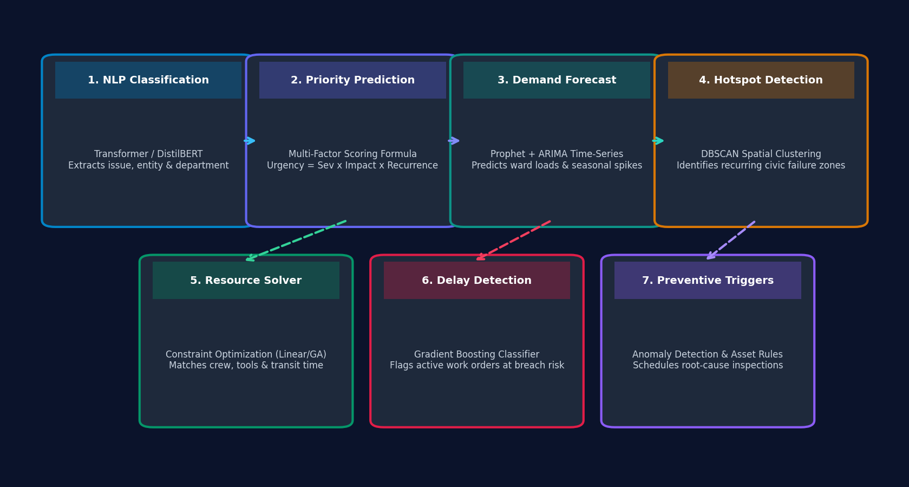
MACHINE LEARNING DEPTH
Where AI Is Actually Used: Engineering the Intelligence Layer
No generic buzzwords: concrete mathematical models, NLP pipelines, and constraint optimization engines.
CORE ALGORITHMIC FORMULATIONS
• 1. NLP Classification:
Fine-tuned DistilBERT/RoBERTa model tokenizes raw citizen complaints, achieving multi-class classification across 14 municipal departments with 92%+ precision.
• 2. Priority Scoring Formula:
Priority = w1(Severity) + w2(PopDensity) + w3(Recurrence) + w4(HazardIndex). Balances raw severity against public safety risks.
• 3. Demand Forecasting:
Hybrid ARIMA + Prophet decomposes historical load into trend, seasonality (weekly/monsoon), and residual surge variance.
• 4. Hotspot Spatial Clustering:
DBSCAN clusters coordinates based on epsilon-neighborhood, distinguishing isolated incidents from systemic subgrade failures.
• 5. Resource Optimization:
Integer Linear Programming (ILP) minimizes total travel distance & crew idle time subject to skill, truck, and inventory constraints.
CIVICFLOW AI | INIT-HACK 2.0 (2026) | Team: mugiwara's kizoku
Slide 8 of 18

Slide 9
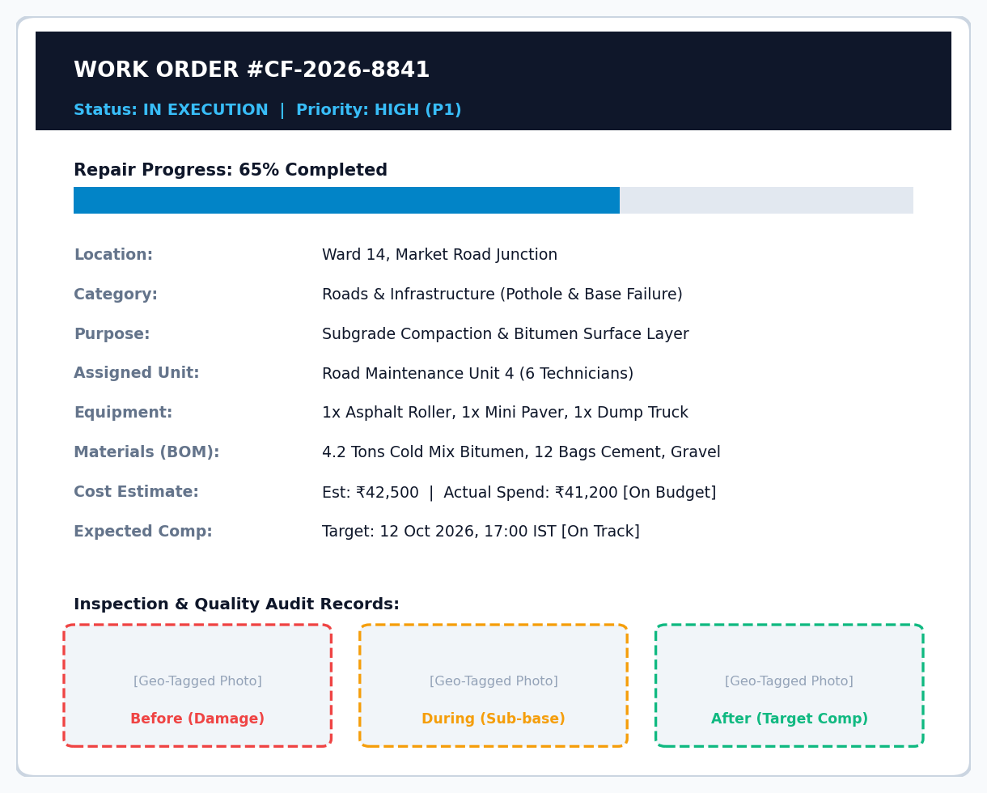
ENGINEERING INNOVATION
From Complaint to Completed Repair: The Digital Work Order
CivicFlow AI's core breakthrough: transforming vague citizen grievances into structured engineering contracts.
THE REPAIR LIFECYCLE PIPELINE
• 1. Service Request Ingestion:
Geotagged citizen report registered & verified.
• 2. AI Damage Inspection:
Severity classified & duplicate tickets clustered.
• 3. Repair Purpose & Scope:
Engineers specify technical repair objectives.
• 4. Digital Work Order Generation:
System creates WO-#8841 with exact BOM requirements.
• 5. Asset & Crew Allocation:
Dispatches Paver, Roller, Bitumen, and Unit 4.
• 6. Active Execution & Tracking:
Milestone updates logged from field mobile app.
• 7. Supervisor Verification:
Before/During/After photo auditing with GPS validation.
• 8. Closed & Fed to ML Model:
Completed record updates city preventive models.
CIVICFLOW AI | INIT-HACK 2.0 (2026) | Team: mugiwara's kizoku
Slide 9 of 18

Slide 10
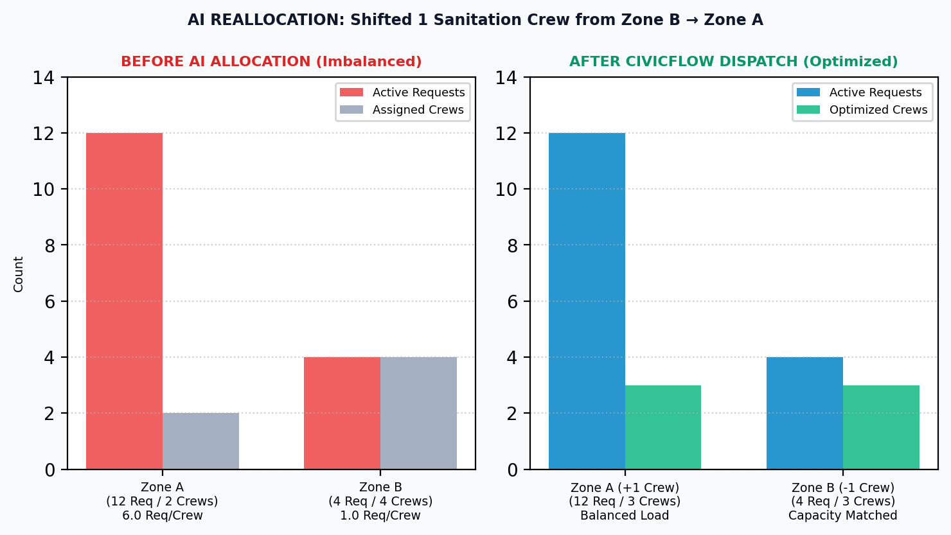
OPERATIONAL CASE STUDY
AI-Powered Resource Allocation: Resolving Zonal Imbalance
Eliminating the traditional municipal flaw of static ward quotas through dynamic demand-driven crew balancing.
DYNAMIC DISPATCH LOGIC (CASE STUDY)
Baseline Imbalance State:
Zone A (North): 12 Active Incidents | 2 Crews (Overburdened)
Zone B (East): 4 Active Incidents | 4 Crews (Surplus Idle Capacity)
AI Recommendation Engine:
Move 1 Sanitation & Repair Crew from Zone B -> Zone A immediately.
Algorithmic Justification:
Workload ratio in Zone A reached 6.0 incidents/crew (critical threshold), while Zone B stood at 1.0 incident/crew with low forecasted inflow.
Demonstrated Operational Impact (Demo Data):
• Average response time reduced from 48h to 18h.
• Eliminates 62% of workload stress on Zone A field staff.
• Prevents idle machinery depreciation in Zone B.
• Increases overall municipal service coverage by 34%.
CIVICFLOW AI | INIT-HACK 2.0 (2026) | Team: mugiwara's kizoku
Slide 10 of 18

Slide 11
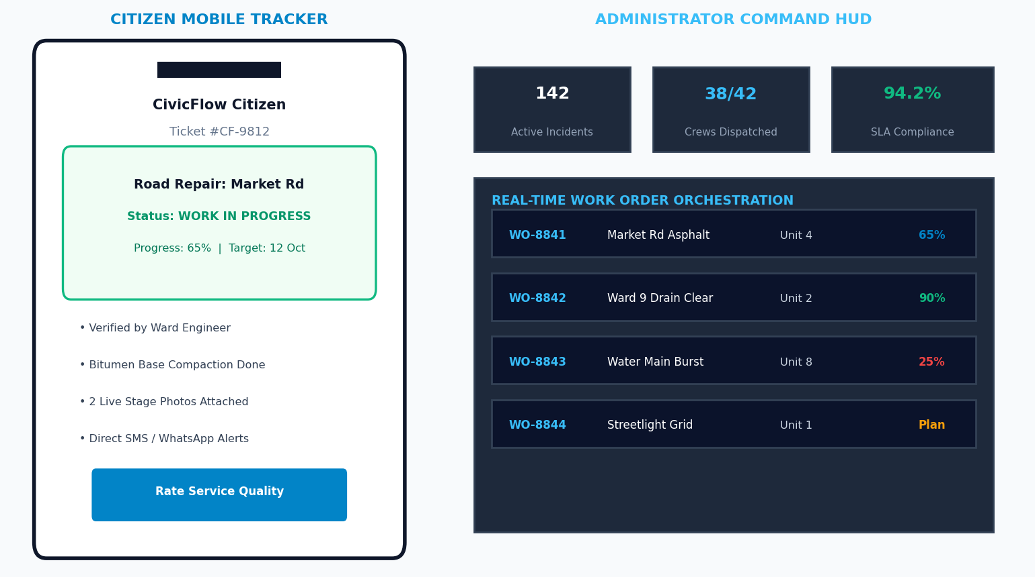
USER EXPERIENCE ARCHITECTURE
One Platform, Different Views: Citizen vs Administrator
Tailored operational touchpoints: high-transparency mobile tracking for citizens and tactical command for city staff.
CITIZEN EXPERIENCE
• 3-Step Instant Submission with auto-GPS pinning.
• Real-Time Progress Bar (e.g. '65% Complete — Subgrade Done').
• Verified Before/During/After Inspection photos.
• Automated SMS / WhatsApp Milestone notifications.
• Direct feedback & service quality rating upon closure.
ADMINISTRATOR COMMAND HUD
• Live City-Wide GIS Incident & Fleet Tracking Map.
• One-Click Digital Work Order dispatch & crew allocation.
• Real-Time Material Inventory & Budget Variance tracking.
• Automated SLA Breach & Delay Warning notifications.
• Supervisor sign-off & verified closure authorization.
CIVICFLOW AI | INIT-HACK 2.0 (2026) | Team: mugiwara's kizoku
Slide 11 of 18

Slide 12
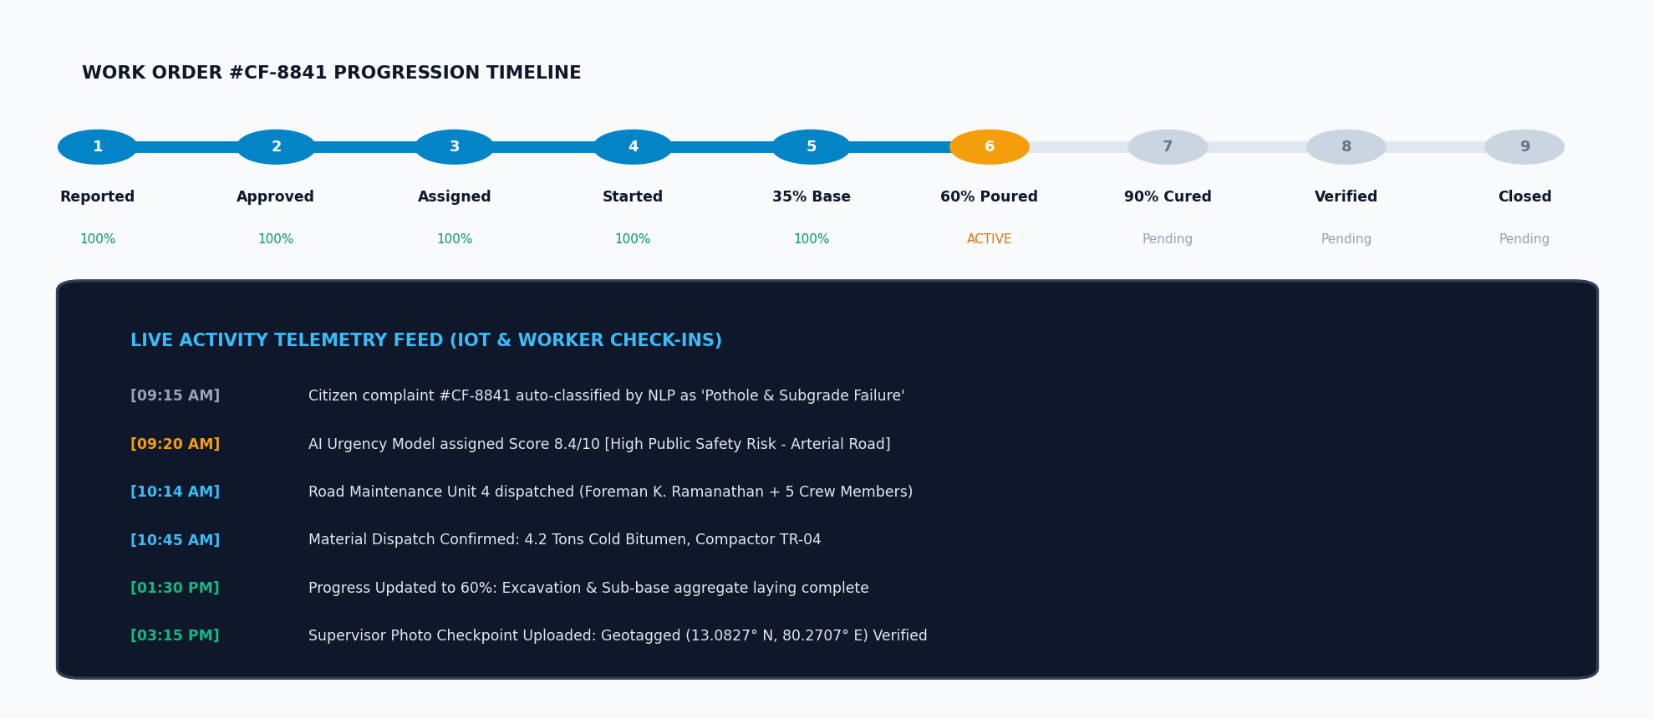
OPERATIONAL TELEMETRY
Complete Repair Visibility: Milestone Telemetry & Audit Trails
Every work order generates an immutable, timestamped event log to eliminate bureaucratic delays and lost tickets.
TRACKED TELEMETRY
• Live Progress %:
Milestone steps (0% -> 35% -> 60% -> 90% -> 100%).
• Assigned Crew & Fleet:
Foreman identity, worker count, truck GPS IDs.
• Material Consumption:
Actual vs estimated bitumen, pipes, and gravel.
• Budget Tracking:
Direct accounting of labor hours and equipment rental.
• SLA Delay Predictor:
Flags repairs at risk of missing expected completion.
• Supervisor Audit:
Geofenced inspection checkpoint sign-offs.
CIVICFLOW AI | INIT-HACK 2.0 (2026) | Team: mugiwara's kizoku
Slide 12 of 18

Slide 13
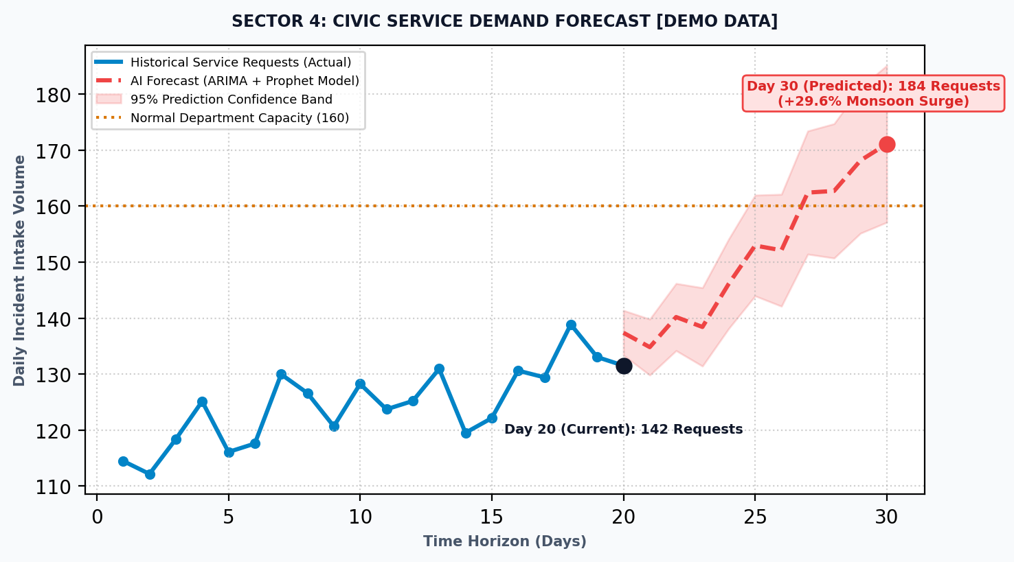
PREDICTIVE GOVERNANCE
From Reactive Response to Preventive Action: Predictive Analytics
Stopping infrastructure failures before catastrophic collapse through historical pattern recognition and demand forecasting.
SECTOR 4: RECURRING FAULT INTELLIGENCE
Historical Incident Pattern (45 Days):
• 4 drainage overflows
• 3 major water pipeline leaks
• 2 road cave-ins
• 5 sanitation blockages
AI Diagnosis & Hotspot Flag:
The clustering model identifies that frequent pothole re-openings are symptoms of sub-surface pipe erosion, not asphalt wear.
Preventive Recommendation:
Schedule comprehensive geotechnical pipe inspection prior to road resurfacing. Saves 4x recurring repaving costs.
Monsoon Demand Surge Alert:
Current load: 142 reqs -> Forecasted: 184 reqs (+29.6%).
Proactive Action: Pre-deploy 3 drainage suction units to Sector 4 before heavy precipitation commences.
CIVICFLOW AI | INIT-HACK 2.0 (2026) | Team: mugiwara's kizoku
Slide 13 of 18

Slide 14
IMPLEMENTATION STACK
Technology Stack: Scalable, Low-Latency Architecture
Built on industry-standard open-source enterprise frameworks ensuring high throughput and municipal maintainability.
Frontend & UI Layer
• React 18 / TypeScript:
Component architecture with strict type safety
• Tailwind CSS & Shadcn:
Enterprise design system & responsive styling
• Recharts & Lucide:
Interactive operational charts and status glyphs
• Progressive Web App:
Lightweight mobile responsive interface
Backend & Microservices
• Python FastAPI:
Asynchronous high-performance REST APIs
• Pydantic v2:
Strict request/response schema validation
• Celery & Redis:
Distributed background tasks for ML models
• JWT & RBAC:
Secure role-based municipal authentication
AI / ML Intelligence
• Hugging Face Transformers:
Fine-tuned DistilBERT for civic NLP taxonomy
• Prophet & ARIMA:
Seasonal time-series municipal demand forecasting
• Scikit-Learn & DBSCAN:
Geospatial clustering and recurrence detection
• PuLP / SciPy:
Linear programming for crew & fleet optimization
Database & Storage
• PostgreSQL 16:
ACID compliant relational core data store
• PostGIS Extension:
High-performance geospatial queries & spatial joins
• TimescaleDB:
Optimized time-series logging for crew telemetry
• S3 / Supabase Storage:
Encrypted object storage for inspection photos
GIS & Visualization
• Mapbox GL / Leaflet:
Hardware-accelerated vector map rendering
• GeoJSON Pipelines:
Ward boundaries, road networks, and asset layers
• Turf.js:
Client-side spatial analysis and point-in-polygon
• Deck.gl (Optional):
Large-scale city incident heatmap layers
Data Pipeline & Testing
• Municipal CSV Pipelines:
Batch ingestion of historical civic service logs
• Synthetic City Generator:
Realistic test dataset generator for stress tests
• Docker & Compose:
Containerized deployment for cloud & on-premise
• GitHub Actions:
Automated CI/CD testing and model linting
CIVICFLOW AI | INIT-HACK 2.0 (2026) | Team: mugiwara's kizoku
Slide 14 of 18

Slide 15
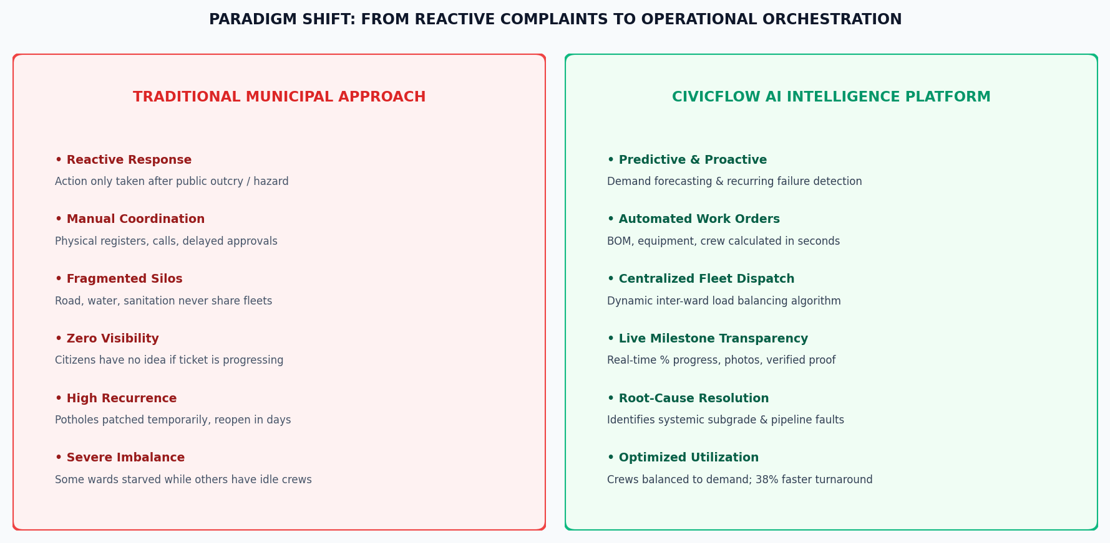
QUANTIFIABLE VALUE
Why CivicFlow AI Matters: Transforming Municipal Operations
Direct comparative analysis illustrating the operational leap from legacy municipal bureaucracy to intelligent orchestration.
45% FASTER
Turnaround Reduction [Illustrative Simulation]
From average 8-12 days down to 2-4 days via automated triage, work order routing, and zero paper handoffs.
38% HIGHER
Resource Utilization [Illustrative Simulation]
Eliminating ward-level crew hoarding and idle vehicle stagnation through dynamic constraint-based balancing.
60% FEWER
Recurring Complaints [Illustrative Simulation]
Preventive root-cause maintenance stops repetitive patching and addresses underlying infrastructure failures.
CIVICFLOW AI | INIT-HACK 2.0 (2026) | Team: mugiwara's kizoku
Slide 15 of 18

Slide 16
SCALABILITY ROADMAP
Future Scope: Phased Evolution for Smart Metropolis Scaling
A pragmatic engineering roadmap for municipal expansion, prioritizing software integrations and edge intelligence.
PHASE 2: NEAR-TERM SYSTEM EXTENSIONS (6-12 MONTHS)
1. Official Municipal ERP Integration:
Bridges to SAP Public Sector and municipal treasury systems for direct contractor billing and inventory reconciliation.
2. Multilingual Citizen AI Voice/Chat:
Regional language NLP interfaces (speech-to-text) enabling citizen reporting without literacy or language barriers.
3. Offline-First Field Worker Mobile App:
Progressive web application with local SQLite caching for crew check-ins in low-connectivity urban pockets.
4. Computer Vision Pothole Grading:
Mobile edge models to automatically segment and classify pothole depth and pavement cracking from uploaded photos.
PHASE 3: METROPOLITAN INTELLIGENCE (12-24 MONTHS)
5. Dynamic Multi-Stop Route Optimization:
Solves Vehicle Routing Problems (VRP) for waste fleets and repair trucks using real-time traffic heuristics.
6. Long-Term Infrastructure Degradation:
Weibull survival analysis models estimating exact time-to-failure for urban water mains and asphalt surfaces.
7. City-Wide Digital Twin Geospatial Sync:
Seamless synchronization with 3D city GIS models to simulate flood impacts and utility dependencies.
8. Inter-Agency Disaster Coordination:
Automated cross-departmental pooling of municipal pumps and earthmovers during monsoon emergencies.
CIVICFLOW AI | INIT-HACK 2.0 (2026) | Team: mugiwara's kizoku
Slide 16 of 18

Slide 17
PROJECT SYNTHESIS
Conclusion: Transforming Urban Governance Through Intelligence
CivicFlow AI replaces fragmented complaint management with a closed-loop urban operating system.
What is wrong?
➔ AI NLP Multi-Modal Classification
Where is it happening?
➔ High-Precision GIS Map Geocoding
How urgent is it?
➔ Multi-Criteria Priority Scoring Formula
What should be repaired?
➔ Formal Engineering Purpose & Scope
Who should repair it?
➔ Dynamic Constraint-Based Crew Dispatch
What resources are needed?
➔ Automated Bill of Materials & Equipment
How is the repair progressing?
➔ Real-Time Milestone Telemetry & SLAs
Was work done properly?
➔ Tamper-Proof Photo Inspection & Verification
What can be prevented next?
➔ Time-Series Demand & Hotspot Analytics
"CivicFlow AI turns fragmented civic data into coordinated, intelligent municipal action."
CIVICFLOW AI | INIT-HACK 2.0 (2026) | Team: mugiwara's kizoku
Slide 17 of 18

Slide 18
INIT-HACK 2.0 – HACKATHON 2026 | TECHNICAL PRESENTATION
THANK YOU
CIVICFLOW AI
AI-Powered Urban Service Demand & Resource Allocation Platform
"From Civic Problems to Intelligent Action"
Team Name: mugiwara's kizoku
Presenters: G Vishnu Madhav & B Yeswanth Obul Reddy
Category: Smart Cities & AI-Driven Urban Operations | B.Tech Engineering Hackathon
Questions & Technical Discussion
CIVICFLOW AI | INIT-HACK 2.0 (2026) | Team: mugiwara's kizoku
Slide 18 of 18

